Slide 1
Children and Families: The Elite DNA Approach
Florida Child and Youth Cabinet
Philip A. Cirrone
Chief Operating Officer
Elite DNA Therapy Services, LLC

Slide 2
Elite DNA Therapy Services, LLC
Established in 2013 as a multi-disciplinary service provider for SWFL
8 offices in 6 counties throughout SWFL
Outpatient and Inpatient services
70% outpatient behavioral health services
15,000 individual patient “encounters” per month
44 psychiatric providers, 52 clinical therapists, and 24 ancillary service providers
40% Medicaid, 30% Medicare, and 30% commercial insurances

Slide 3
Community Landscape Prior to Elite DNA
Long waiting lists for child and adolescent psychiatric services
Pediatricians managing behavioral medications
High trial and error
Providers working in silos
Poor Collaboration
43% show-rate when referred from pediatricians office
Reactive vs proactive

Slide 4
Care Coordination
“Intake”
Assessment of needs
Expectation of patient and provider
Release of Information
Data Collection( CFAR/FAR)
Patient Advocate
Follow-up with patient and referring provider

Slide 5
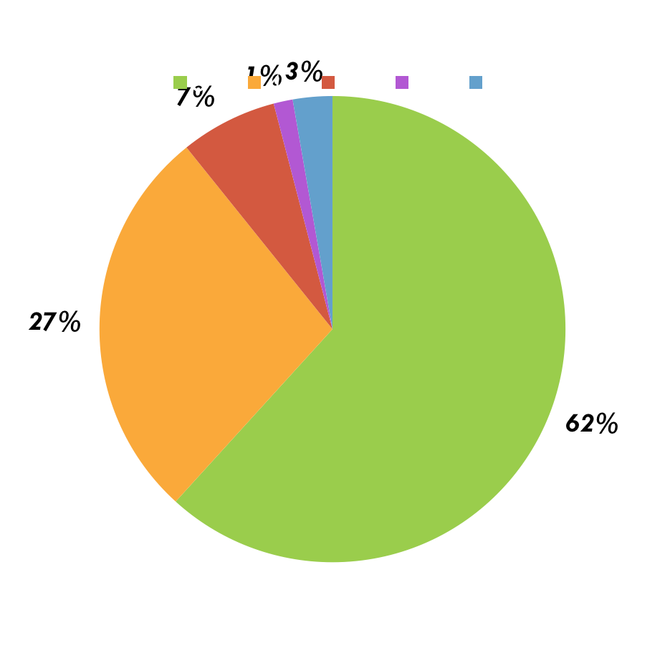
Care Coordination Data Sample
Clients were asked the following:
“How was your last therapy appointment? Please rank on a satisfaction scale ranging from 1 to 5.”
5: 699
4: 311
3: 76
2: 15
1: 31
Total: Responses: 1,132

Slide 6
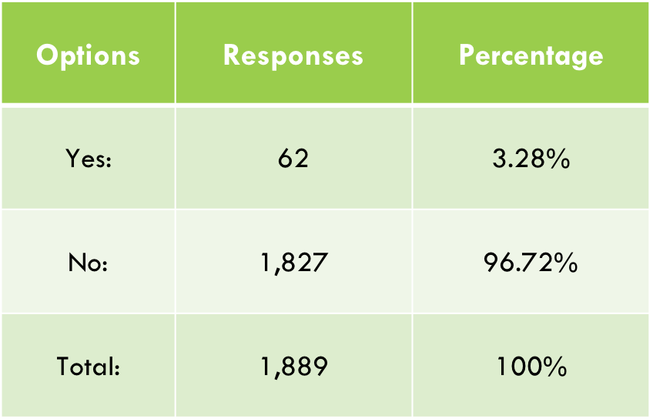
Care Coordination Data Sample #2
Clients were asked the following:
“Have you visited the E.R., been baker acted, or admitted to an emergency department since our last contact?”

Slide 7
A Model of Collaboration
Shared EHR
Case conferences
Patient/Family Centered
“One stop shop”
Data Driven

Slide 8
Behavioral Health Services
Child and Adolescent Psychiatrist
Shared Cases
Family Therapy
Community Based Services
Telehealth
Quick Access

Slide 9
Collaborative Care Model
Grant awarded to Elite DNA Therapy Services to help provide services to children diagnosed with Autism Spectrum Disorder.
Written due to insurance difficulties for many patients in achieving therapy as well as due to statewide need for services.
Current estimates of an Autism Diagnosis children is 1 in 59 children.
The grant covers Speech Therapy, Occupational Therapy, Applied Behavioral Analysis Therapy, Mental Health Counseling, and Psychiatric visits.
Since we received the grant over 40 children have benefitted from it’s services.

Slide 10
Integration with Physical Medicine
Pediatric Offices, Primary Care Doctors
120% increase intake show rate- “warm hand-off”
7- day behavioral health follow-ups, if needed, immediate access
24% decline in show rate after 24-hours, 1% each additional day
Better communication between providers
More comfortable to refer vs. trial and error
More prevention focused (PHQ-9)

Slide 11
Questions?

